Slide 1
HOSPITAL MANAGEMENT SYSTEM
This is where our presentation begins
By: Ridhi Thakur , Shiya Mer , Harneet Kaur , Ira Gupta

Slide 2
CONTENTS OF THIS PRESENTATION
This presentation comprises of the following information :
Patient management: This module manages patient records, including patient registration, admission, discharge, and transfer.
Appointment scheduling: This module manages patient appointments, including scheduling, rescheduling, and cancellations.
Staff management: This module manages the information of hospital staff, including doctors, nurses, technicians, and administrative staff.
Reporting and analytics: This module generates reports and analytics based on the data collected in other modules. It includes features such as patient outcomes, staff productivity, and financial performance.

Slide 3
TABLE OF CONTENTS
01
04
02
03
OBJECTIVES
BACKEND
05
SCHEMA
QUERIES
06
ER DIAGRAM
CONCLUSION

Slide 4

ABSTRACT
Our project Hospital Database Management system includes registration of patients, storing their disease details into the system. It will also contain doctor’s information and will digitalize the whole billing system. It has the facility to give a unique id for every patient and stores the details of every patient and staff automatically. It includes a search facility to know the current status of each room. User can search availability of a doctor and the details of a patient using the id. And the whole process conducted by Administrator.

Slide 5

1
PROJECT DESCRIPTION

Slide 6
BACKGROUND
Hospital management systems were developed to address these challenges and provide a more efficient way to manage hospital operations. These systems typically include modules for patient management, appointment scheduling, staff management, inventory management, and billing and payment processing.
Today, hospital management systems are widely used in hospitals and healthcare facilities of all sizes, ranging from small clinics to large, multi-specialty hospitals. They have helped to streamline hospital operations, reduce administrative costs, and improve patient care.
A Hospital Management System is a software solution designed to manage the operational and administrative tasks of a hospital or healthcare facility. The system aims to automate manual processes and improve the quality of patient care by providing healthcare professionals with real-time access to patient data and other critical information.

Slide 7

GOALS
CHALLENGE
RESULTS
SOLUTION
Implementing a hospital management system can bring significant benefits to a healthcare facility, such as improved efficiency, patient care, and financial performance. However, it can also present some challenges
The implementation of a hospital management system can help healthcare facilities to provide better care to their patients, while improving operational efficiency and financial performance.
implementing a hospital management system requires a systematic approach to ensure a successful implementation that meets the needs of the healthcare facility

Slide 8
IDEAS
The hospital database includes all the necessary patient data. The disease history, lab reports, prescribed treatment can be accessed by doctors without much delay in order to make an accurate diagnosis and monitor the patient's health. It enables lower risks of mistakes.
The project maintains two levels of users:
• Administrator.
• User Level-Data Entry Operator.

Slide 9
RELATIONAL SCHEMA

Slide 10
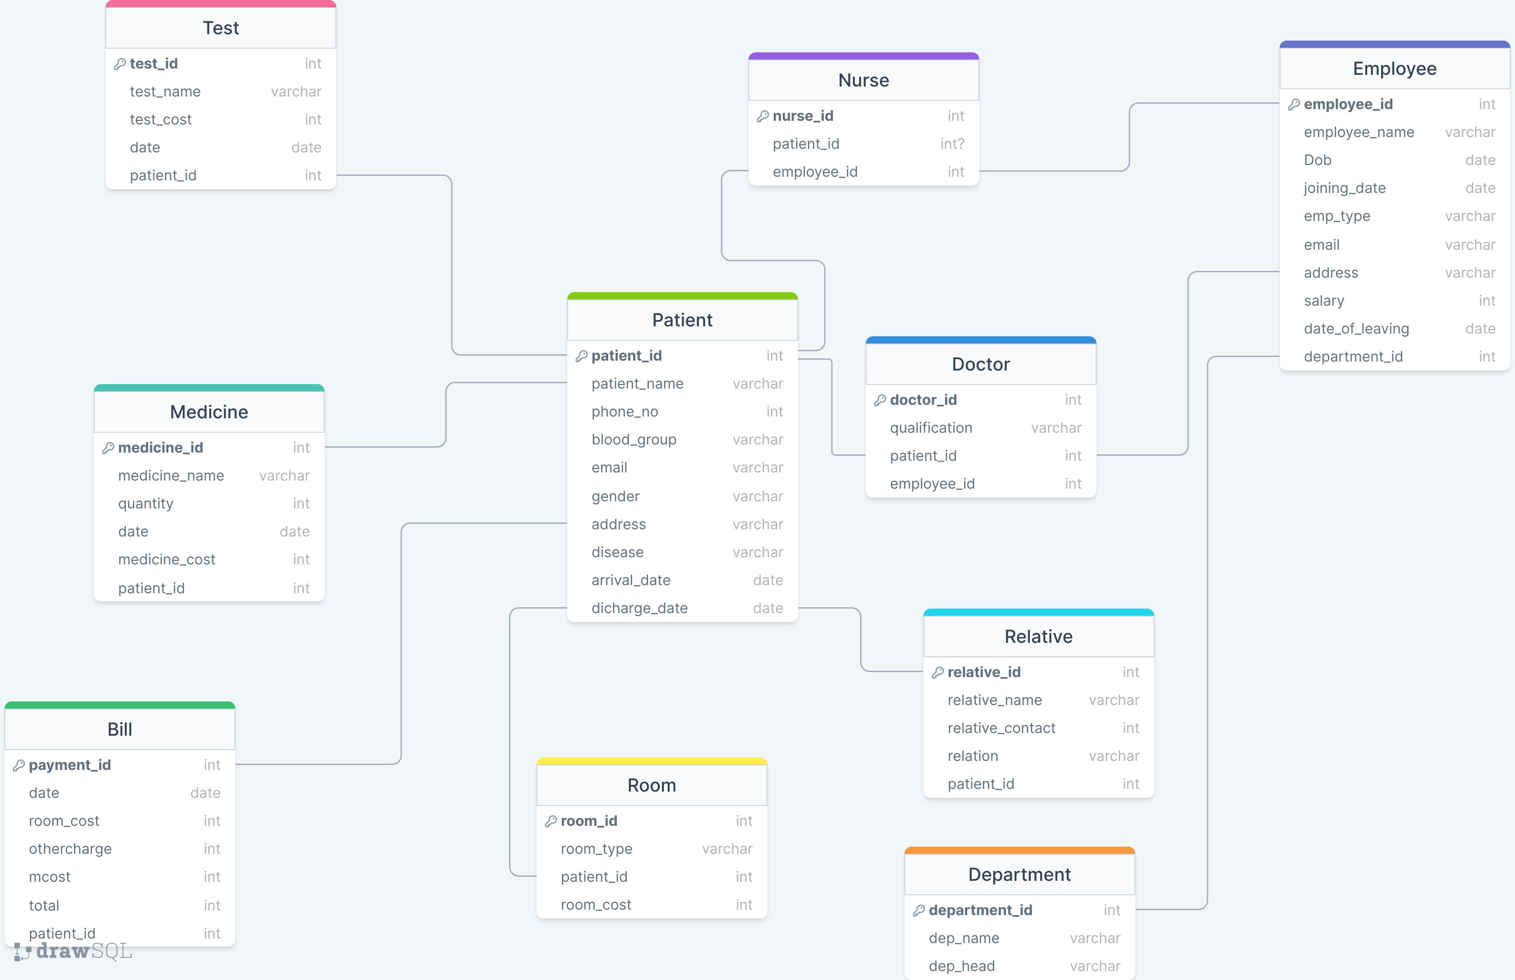

Slide 11
ER DIAGRAM

Slide 12
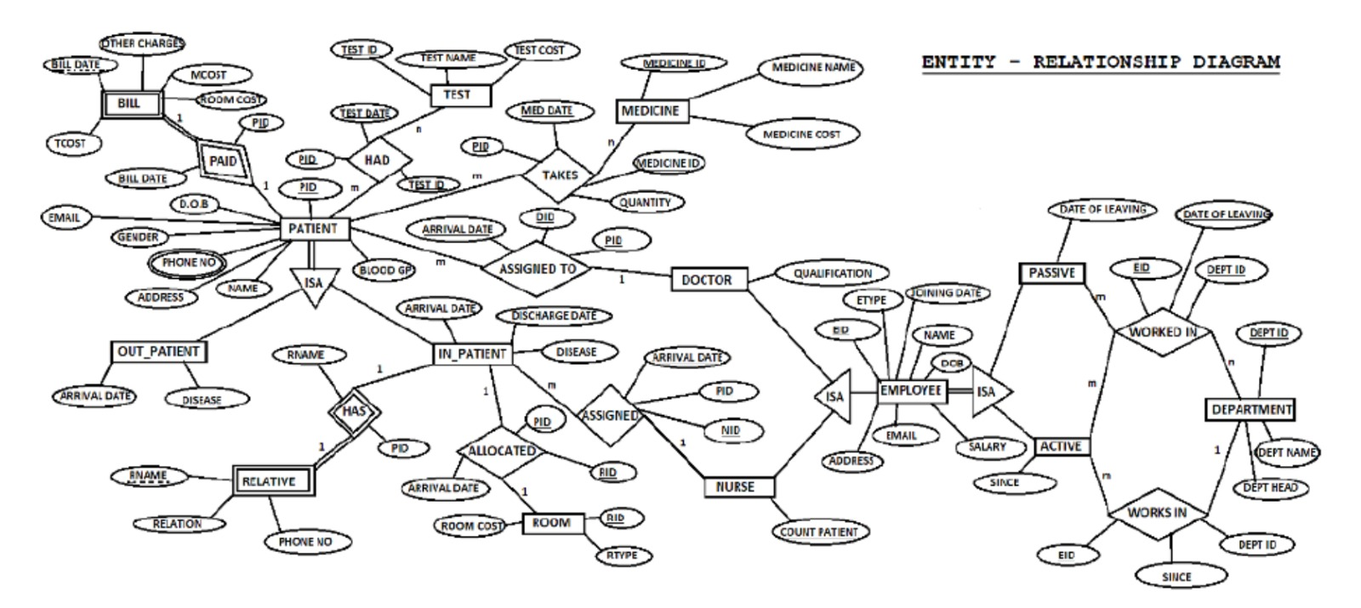

Slide 13

ER to TABLE

Slide 14
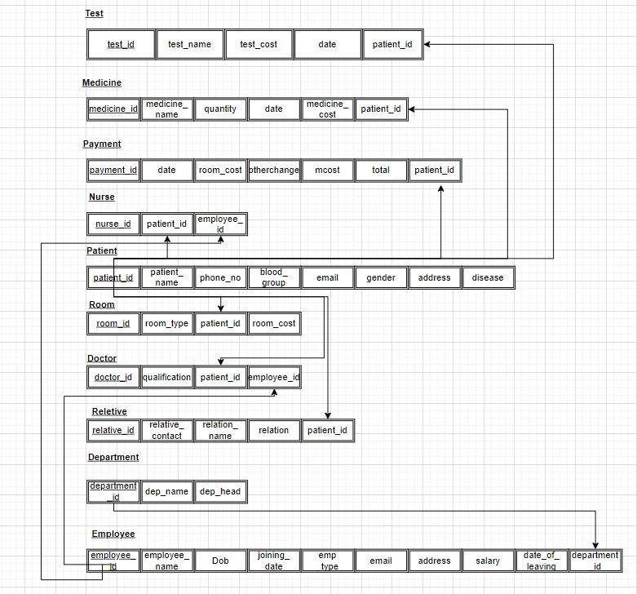

Slide 15

FUNCTIONS,PROCEDURES AND EXCEPTIONS

Slide 16
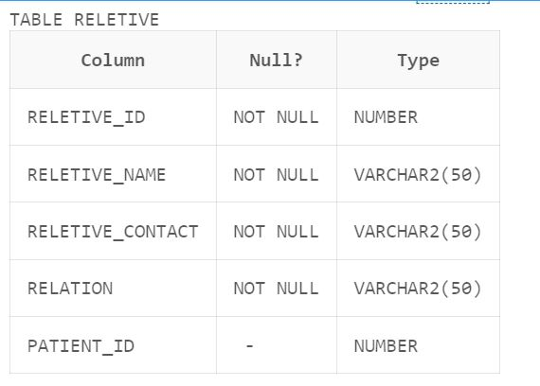
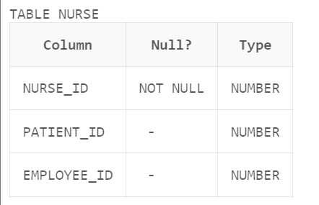
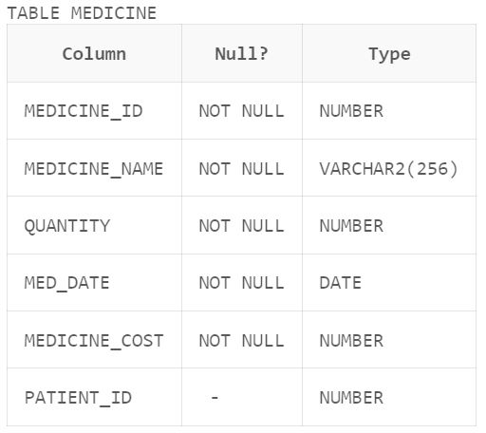
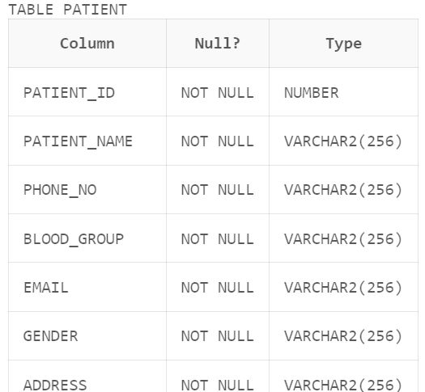
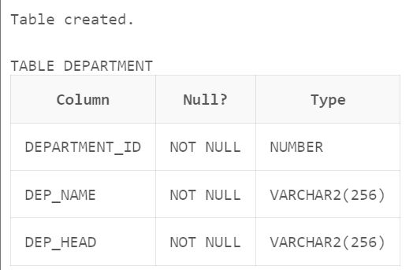
Create TABLE ;
create table patient(
patient_id int primary key,
patient_name varchar(256) not null,
phone_no varchar(256) not null,
blood_group varchar(256) not null,
email varchar(256) not null,
gender varchar(256) not null,
address varchar(256) not null,
disease varchar(256) not null,
arrival_date date not null,
discharge_date date not null
);

Slide 17
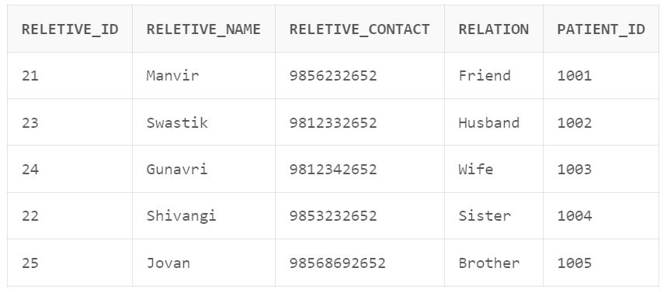
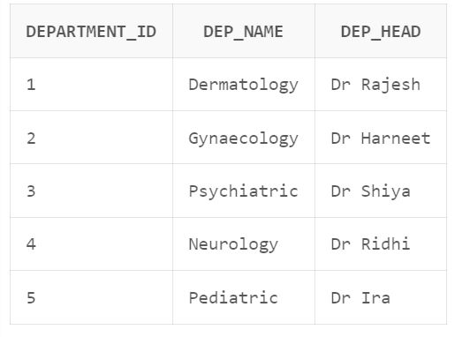
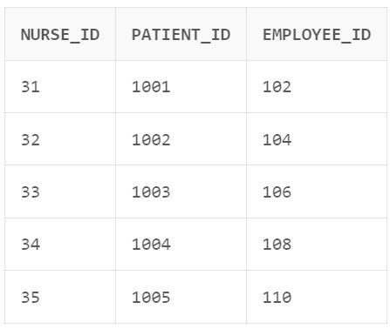
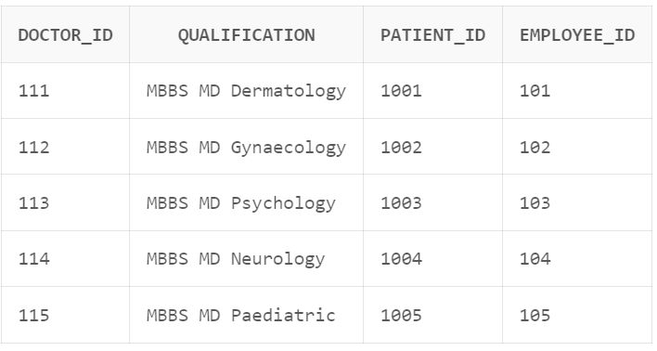
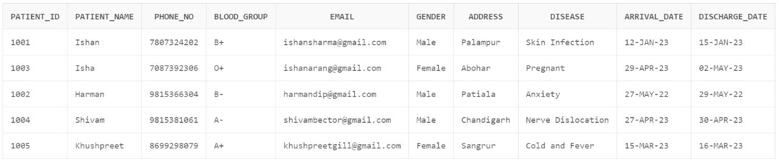
Insert values into TABLE ;
insert into patient values(1003,'Isha','7087392306','O+','ishanarang@gmail.com','Female','Abohar','Pregnant','29-April-2023','02-May-2023');
insert into patient values(1004,'Shivam','9815381061','A-','shivambector@gmail.com','Male','Chandigarh','Nerve Dislocation','27-April-2023','30-April-2023');

Slide 18
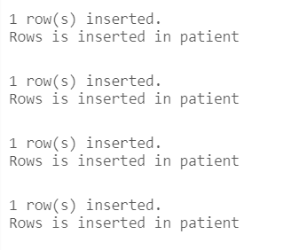
Triggers in TABLE ;
CREATE OR REPLACE TRIGGER trg_patient
AFTER INSERT ON patient
FOR EACH ROW
BEGIN
dbms_output.put_line('Rows is inserted patient');
END;

Slide 19
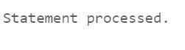
Exceptions in TABLE ;
BEGIN
UPDATE employee
SET salary = 50000
WHERE employee_id = 16;
EXCEPTION
WHEN NO_DATA_FOUND THEN
DBMS_OUTPUT.PUT_LINE('Employee record not found');
WHEN OTHERS THEN
DBMS_OUTPUT.PUT_LINE('Error updating employee record: ' || SQLERRM);
END;

Slide 20
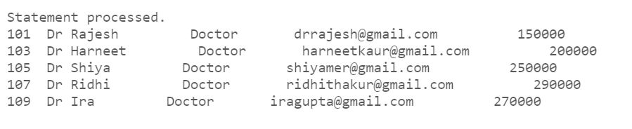
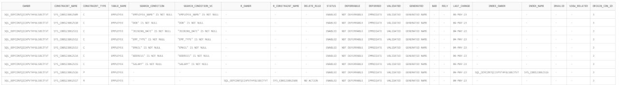
Cursors and Constraints into TABLE ;
DECLARE
CURSOR C1 IS SELECT * FROM employee order by salary desc ;
rec employee%rowtype;
begin
FOR rec in C1 loop
dbms_output.put_line(rec.employee_id||' '||rec.employee_name||' '||rec.emp_type||' '||rec.email||' '||rec.salary);
end loop;
END;
ALTER TABLE medicine ADD CONSTR AINT chk_medicine_cost CHECK (medicine_cost >= 0);
ALTER TABLE room ADD CONSTRAINT chk_room_cost CHECK (room_cost > 0);
ALTER TABLE bill ADD CONSTRAINT chk_total CHECK (Total > 0);
ALTER TABLE employee ADD CONSTRAINT chk_joining_date CHECK (date_of_leaving IS NULL OR joining_date < date_of_leaving
);

Slide 21
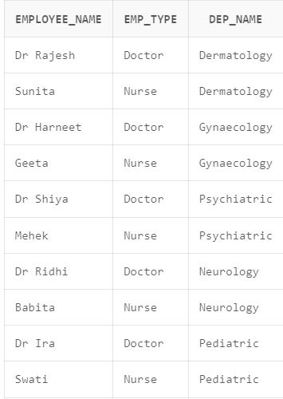
Queries into TABLE ;
SELECT e.employee_name, e.emp_type, d.dep_name
FROM employee e
JOIN department d ON e.department_id = d.department_id
WHERE e.emp_type IN ('Doctor', 'Nurse');

Slide 22
Scope of project
The scope of a Hospital Management System (HMS) can be quite extensive and can cover all aspects of managing a hospital or healthcare facility.

Slide 23

The future improvements and scope of a Hospital Management System (HMS) are vast and varied. Here are some potential areas for improvement and expansion: Mobile App Integration Telemedicine Wearable Technology Integration. Patient Feedback and Satisfaction Monitoring Integration with External Healthcare Providers Blockchain Integration.
FUTURE SCOPE

Slide 24

CONCLUSIONS
The project Hospital Data Management System (MDBS) is for computerizing the working in a hospital. It takes care of all the requirements of an average hospital and is capable to provide easy and effective storage of information related to patients that come up to the hospital. It generates test reports, provide medicines prescribed to patient and doctor. It also provides billing facility on the basis of patient’s status whether it is an indoor or outdoor patient. The system also provide the facility of backup as per the requirement.

Slide 25
OUR TEAM
SHIYA MER 102117045
HARNEET KAUR
102117052
RIDHI THAKUR
102117032
IRA GUPTA
102117057

Slide 26
REFERENCES
https://existek.com/blog/hospital-managment-system
https://www.researchgate.net/publication/343149774_Hospital_Management_System
https://www.academia.edu/5202538/HOSPITAL_MANAGEMENT_SYSTEM_A_Project_work_submitted_to_the_DEPARTMENT_OF_COMPUTER_APPLICATIONS_

